Slide 1
Custom VPN
Kishore Kumar K

Slide 2
How to Create a Custom VPN?
Here are the steps for creating a custom VPN:
Need to install Easy-RSA and OpenVPN in Ubuntu.
Create the main certificate user, server, and client certificates with keys.
Transfer files from Ubuntu to the host machine.
Try to create the server configuration file in Ubuntu and the client oven file in the host machine.
Connect the client VPN through OpenVPN.

Slide 3
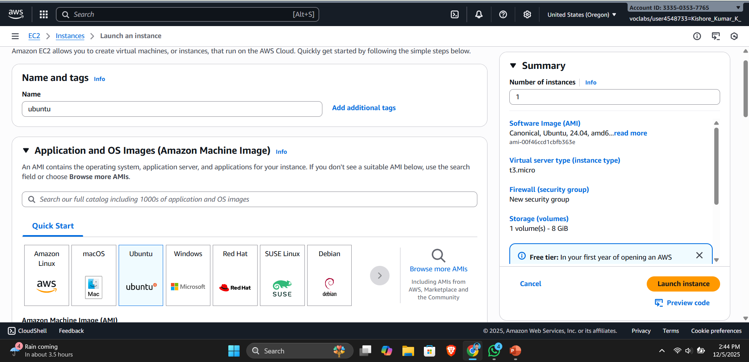
Creating Ubuntu Instance

Slide 4
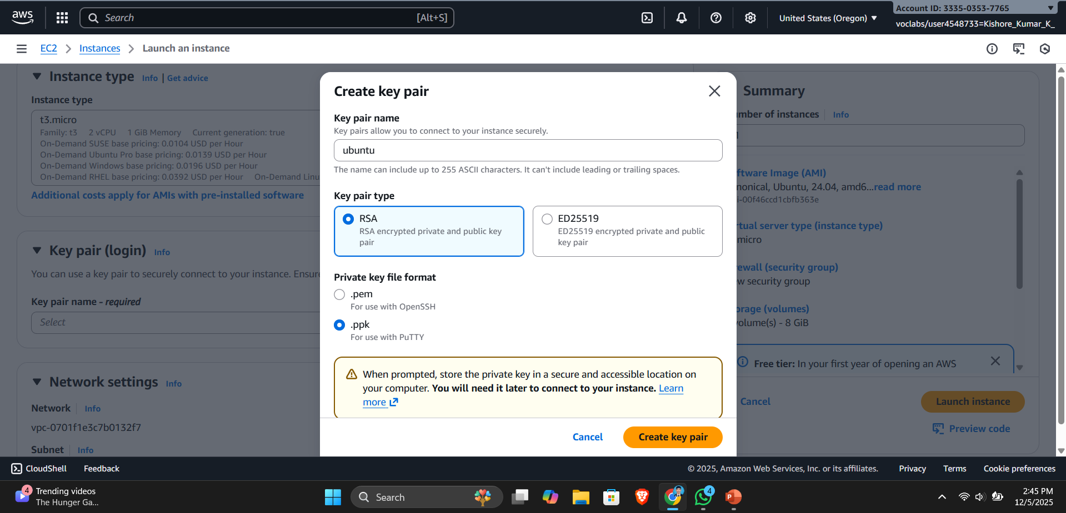
Generating key for Instance

Slide 5
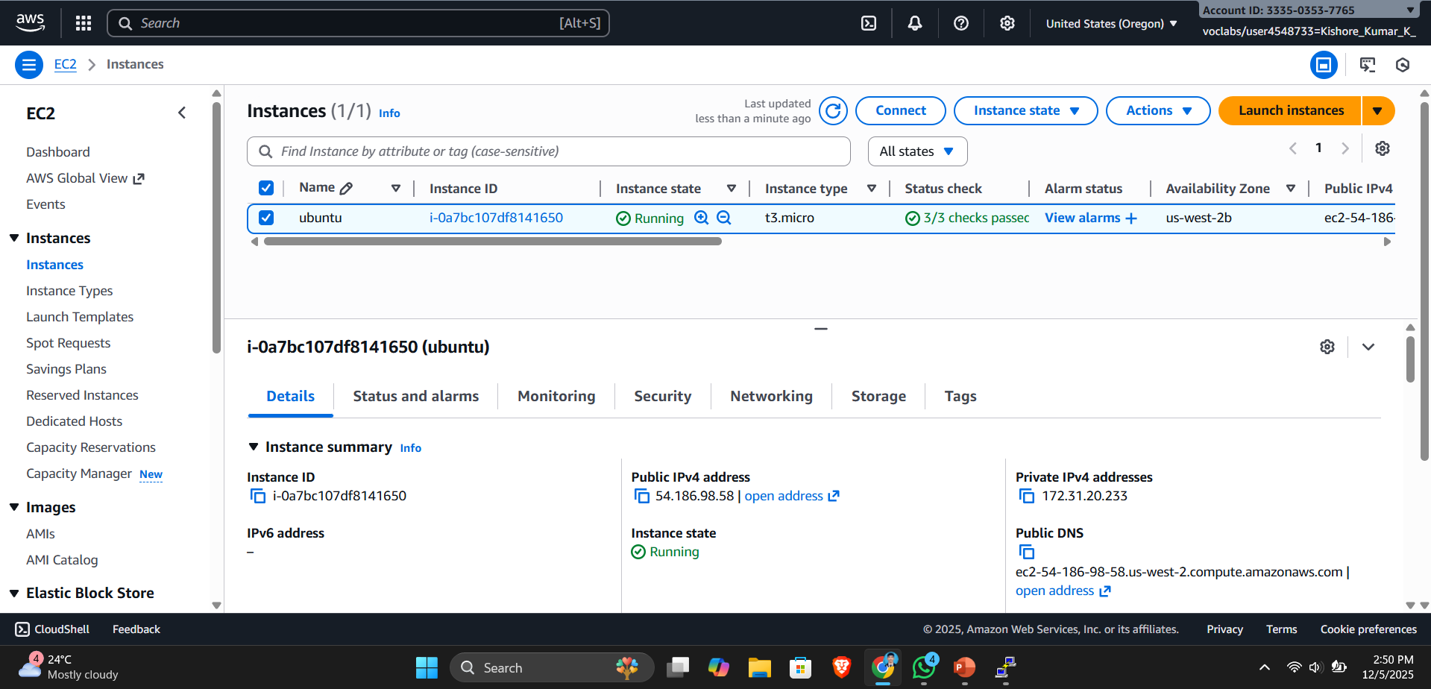
Here you can see the Running Instance

Slide 6
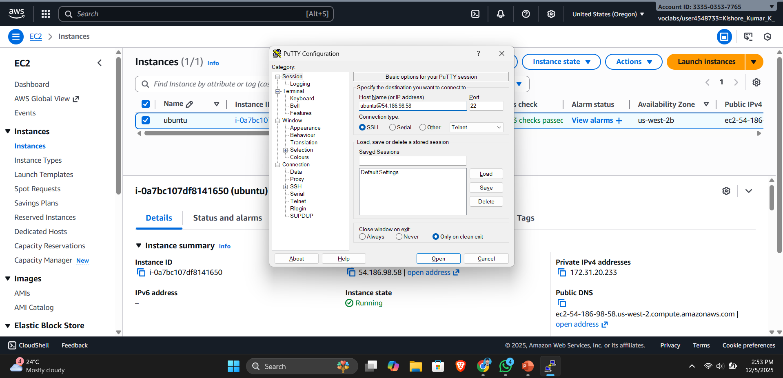
Try to connect the Instance through Putty
Here i have used the Ubuntu user to connect with PUTTY

Slide 7

Try to connect the Instance through Putty
Here i have added the the secrete key to access the instance

Slide 8
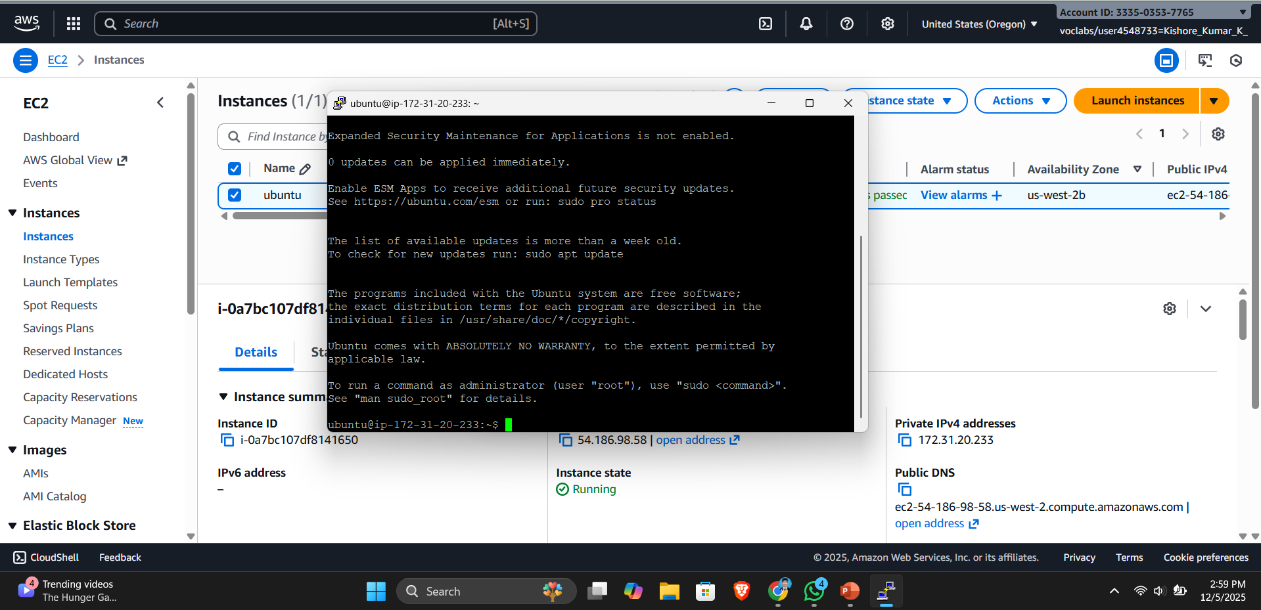
Logged in to the ubuntu user

Slide 9
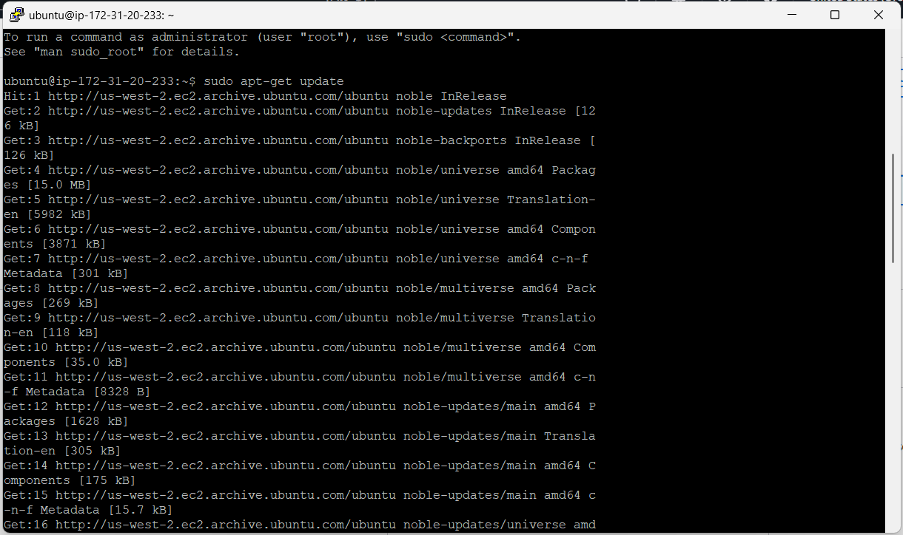
Try to connect the Instance through Putty
First we need to update the system -> sudo apt-get update

Slide 10
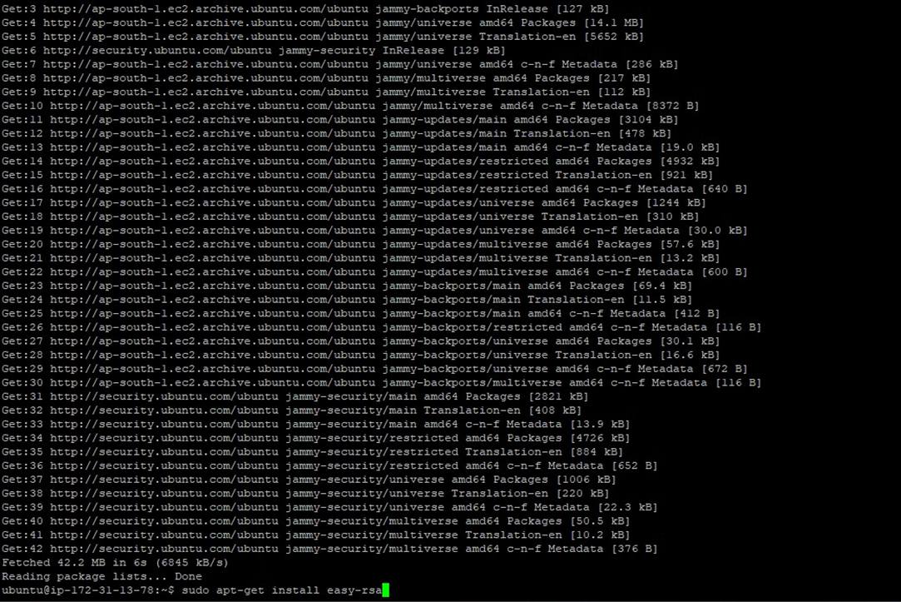
Installing easy-rsa
Install easy-rsa -> sudo apt-get install easy-rsa

Slide 11
Installing easy-rsa
Install easy-rsa -> sudo apt-get install easy-rsa

Slide 12
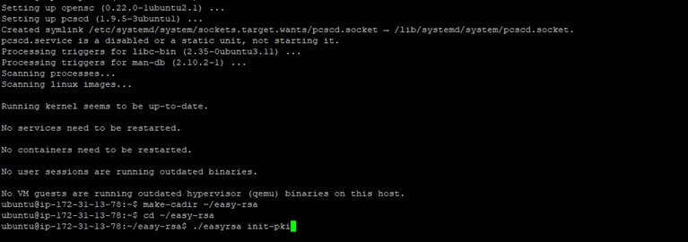
Creating Folder and Initializing the easy-rsa
Creating easy-rsa folder -> make-cadir ~ /easy-rsa
Changing the directory -> cd ~ /easy-rsa
Initializing the easy-rsa -> ./easyrsa init-pki

Slide 13
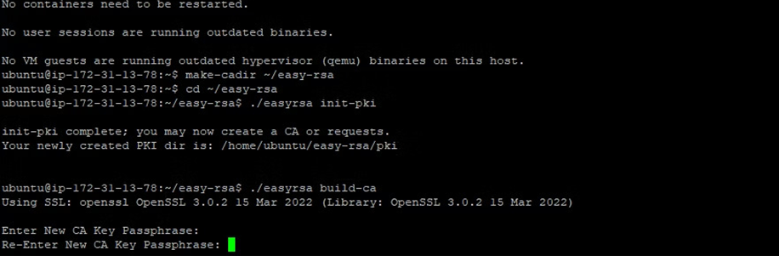
Building the easy-rsa Certificate
Creating Certificate -> ./easyrsa build-ca
Enter the password for the certificate.

Slide 14
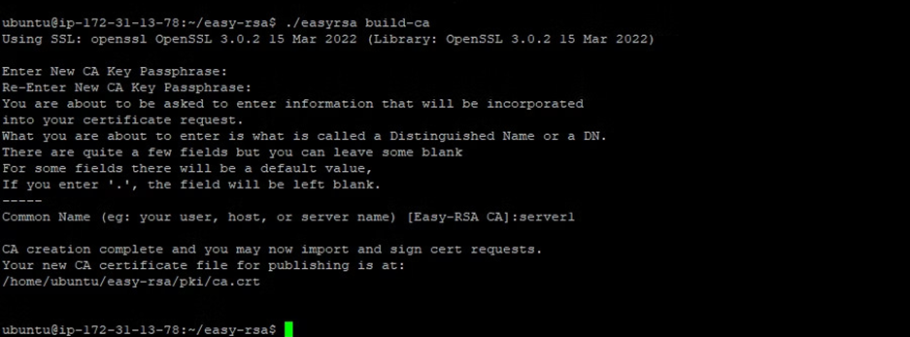
Easy-rsa certificate
Enter the certificate name -> server1
Here you can see the CA Certificate

Slide 15
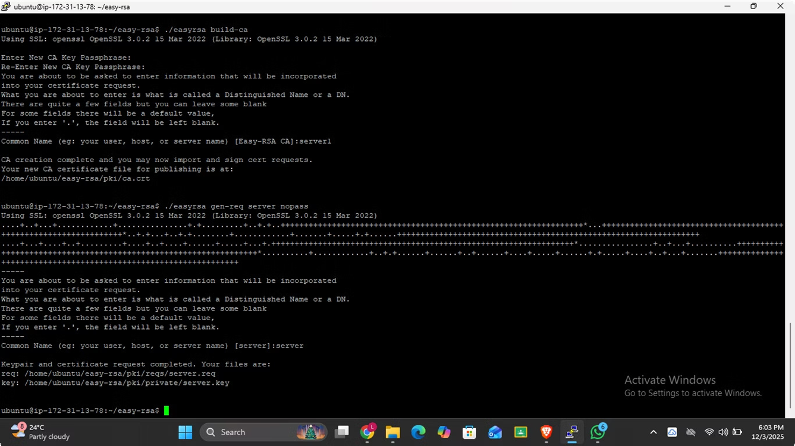
Generate the server-side certificate
Generating the server-side certificate -> ./easyrsa gen-req server nopass
Need to enter the server name -> server

Slide 16
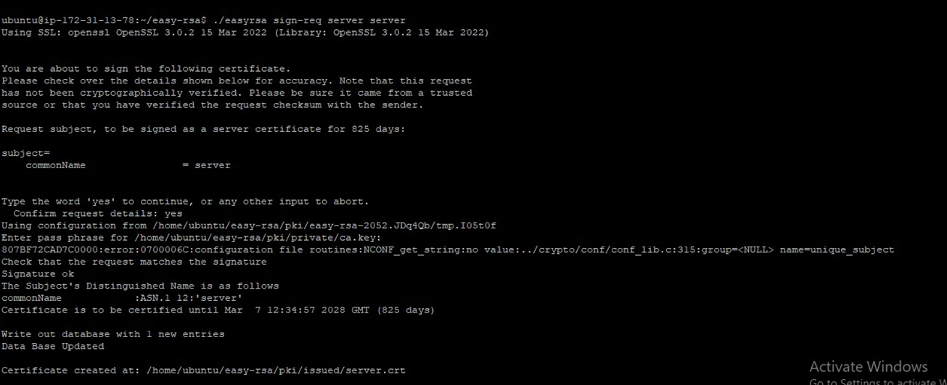
Adding a key to server-side certificate
Adding key to server-side certificate -> ./easyrsa sign-req server server
Conform the entered key -> Yes

Slide 17
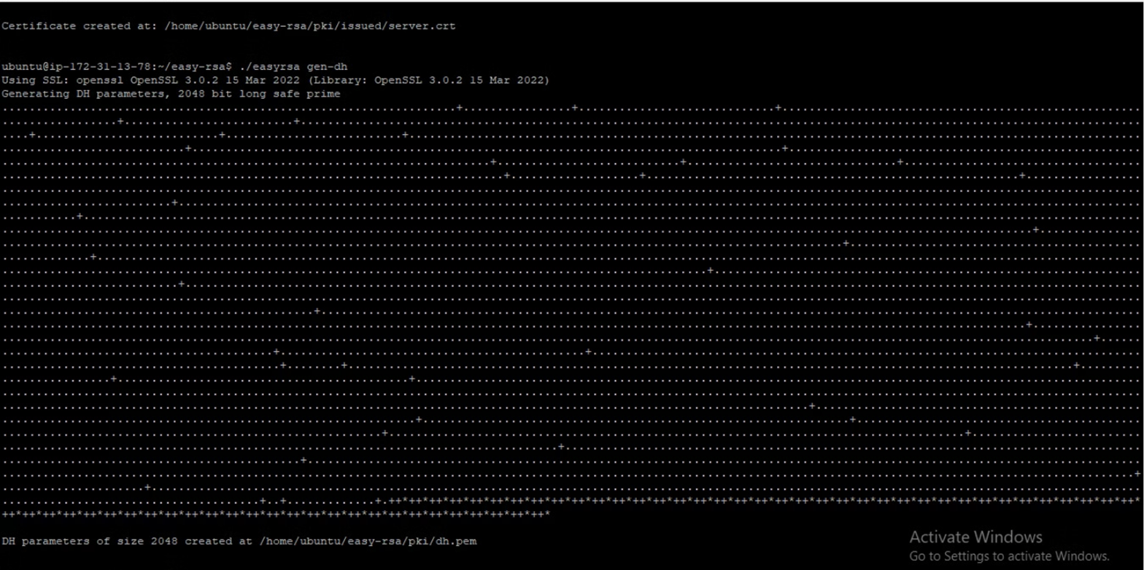
Creating dh.pem file
Generating dh.pem file -> ./easyrsa gen-dh

Slide 18
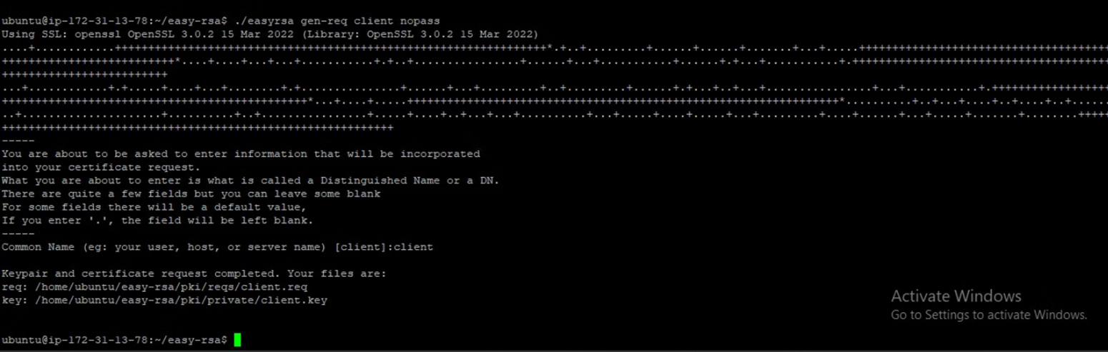
Generate the client-side certificate
Generating the client-side certificate -> ./easyrsa gen-req client nopass
Need to enter the client name -> client

Slide 19
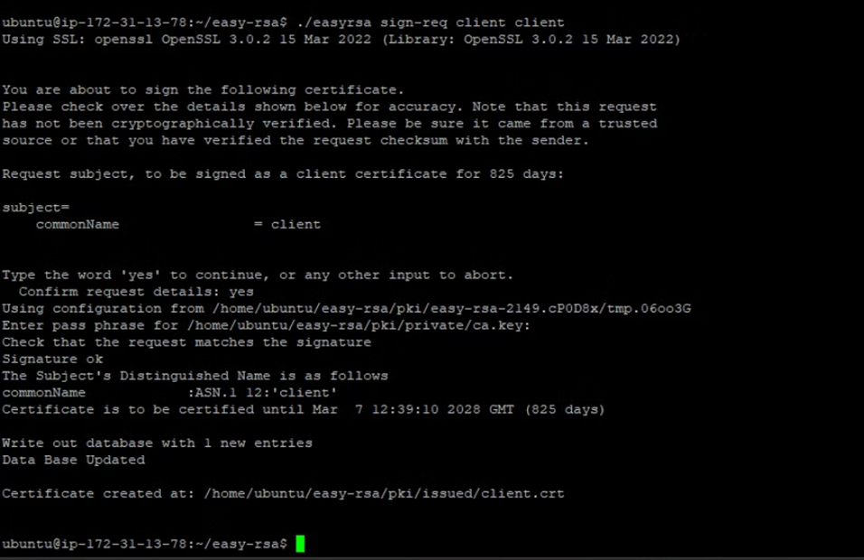
Adding a key to client-side certificate
Adding key to client-side certificate -> ./easyrsa sign-req client client
Conform the entered key -> Yes

Slide 20
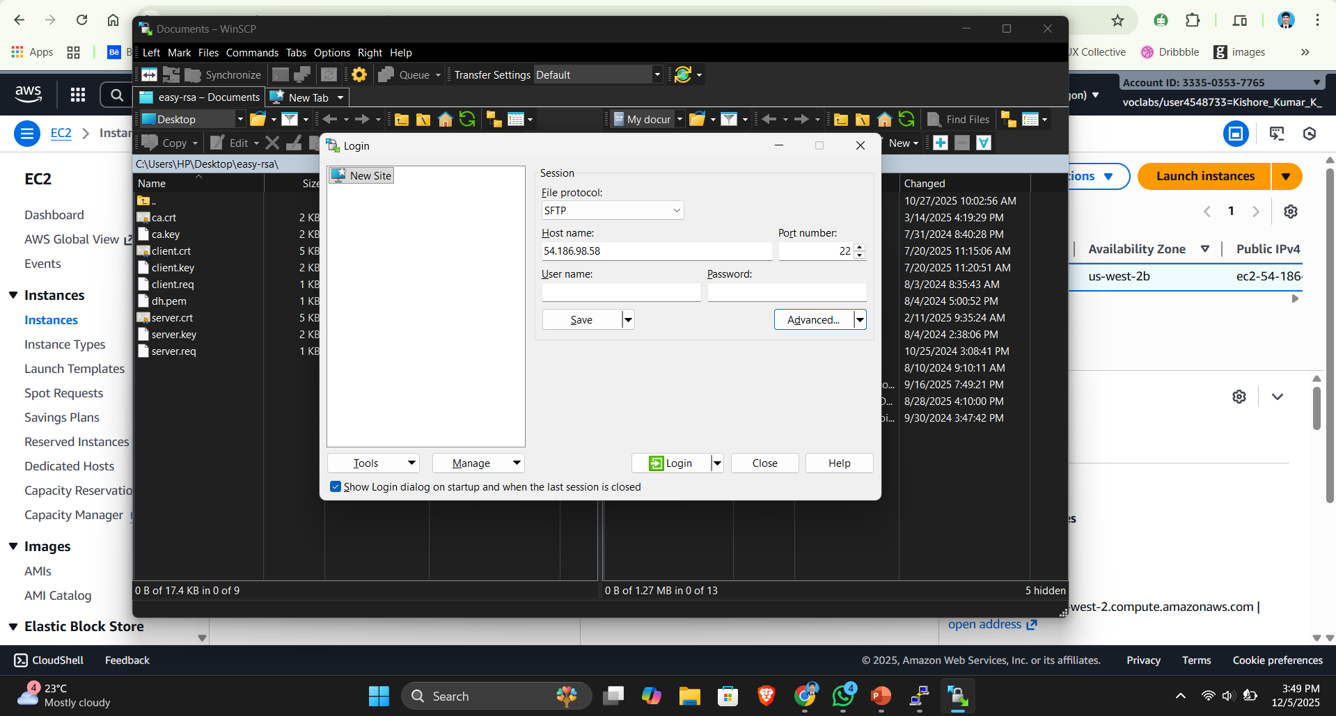
Connecting with WinSCP
Add Instance Ip Address and Authentication Key

Slide 21
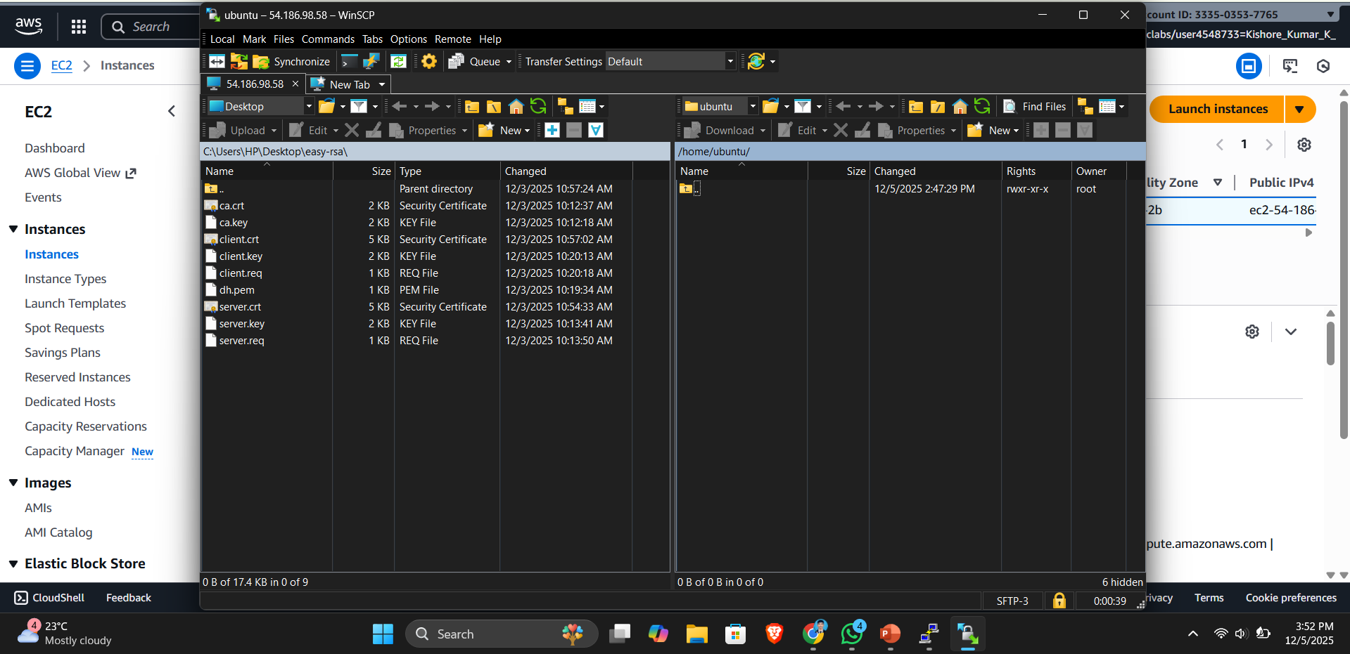
Connecting with WinSCP
Copy-pasting all the certificates and keys from VM to the host machine via WinSCP

Slide 22
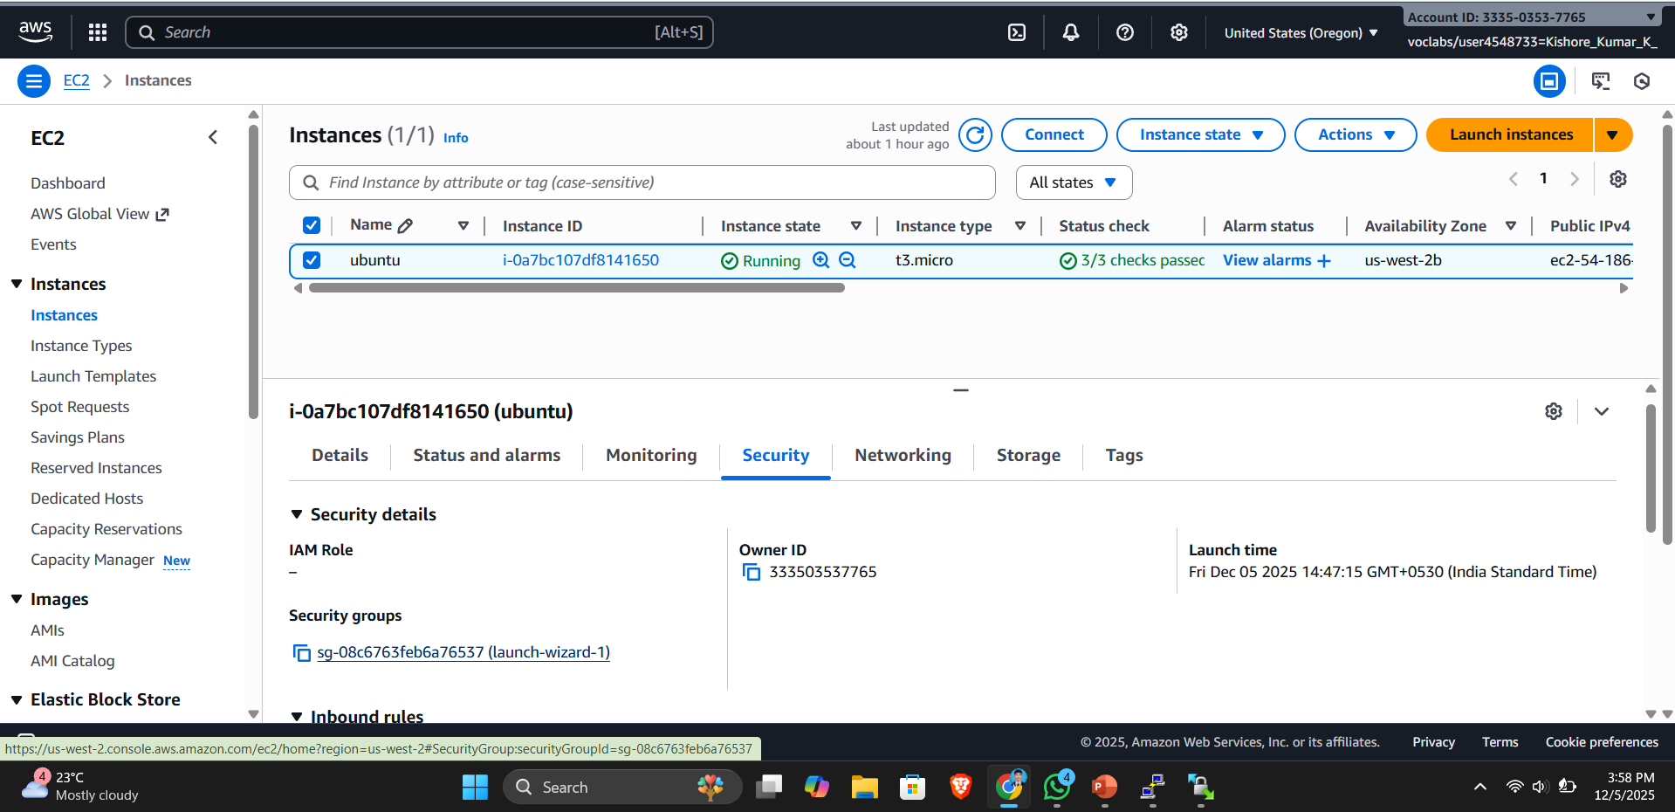
Add custom UDP
Adding custom UDP in security group

Slide 23
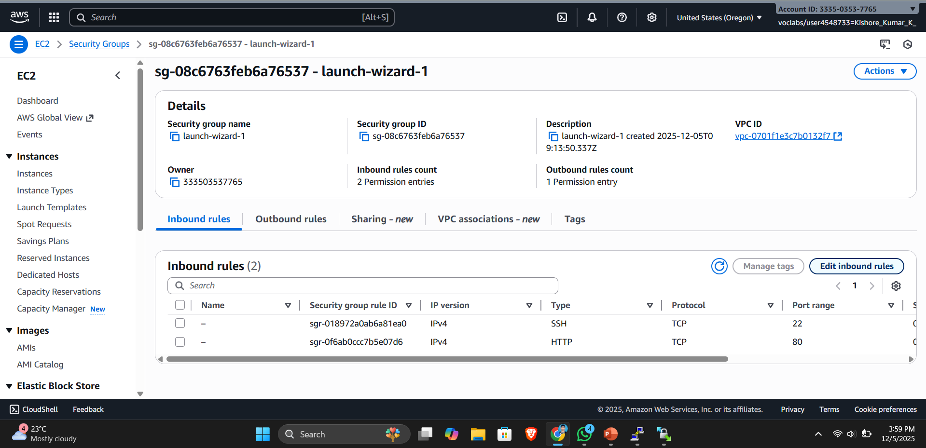
Edit inbound Rules
Click on edit Inbound Rules

Slide 24
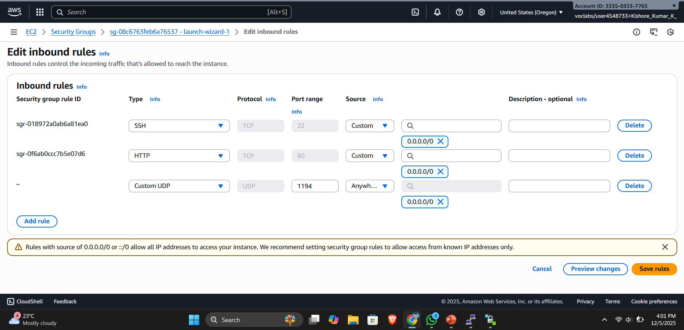
Edit inbound Rules
Add 1194 as the port range in the custom UDP.

Slide 25
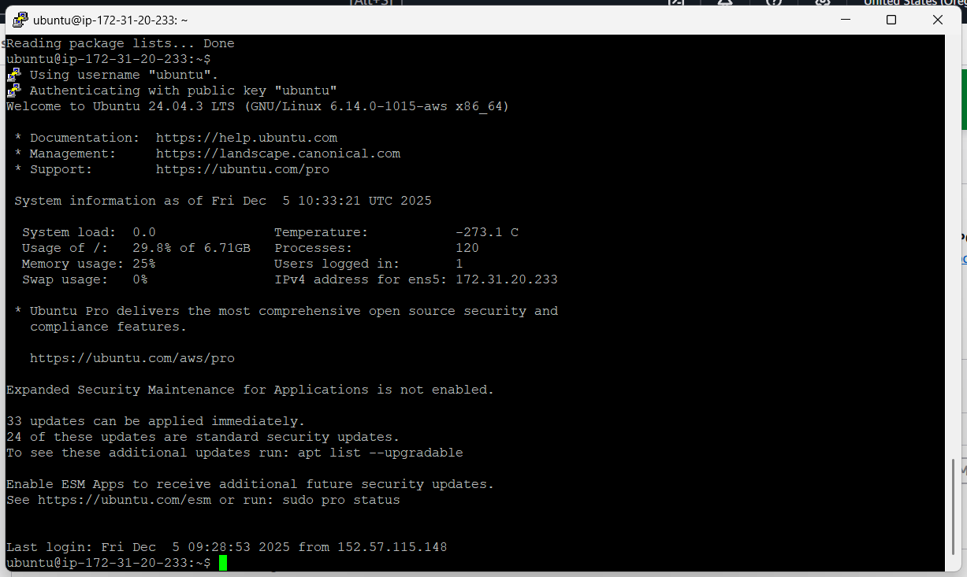
Restart the Session

Slide 26
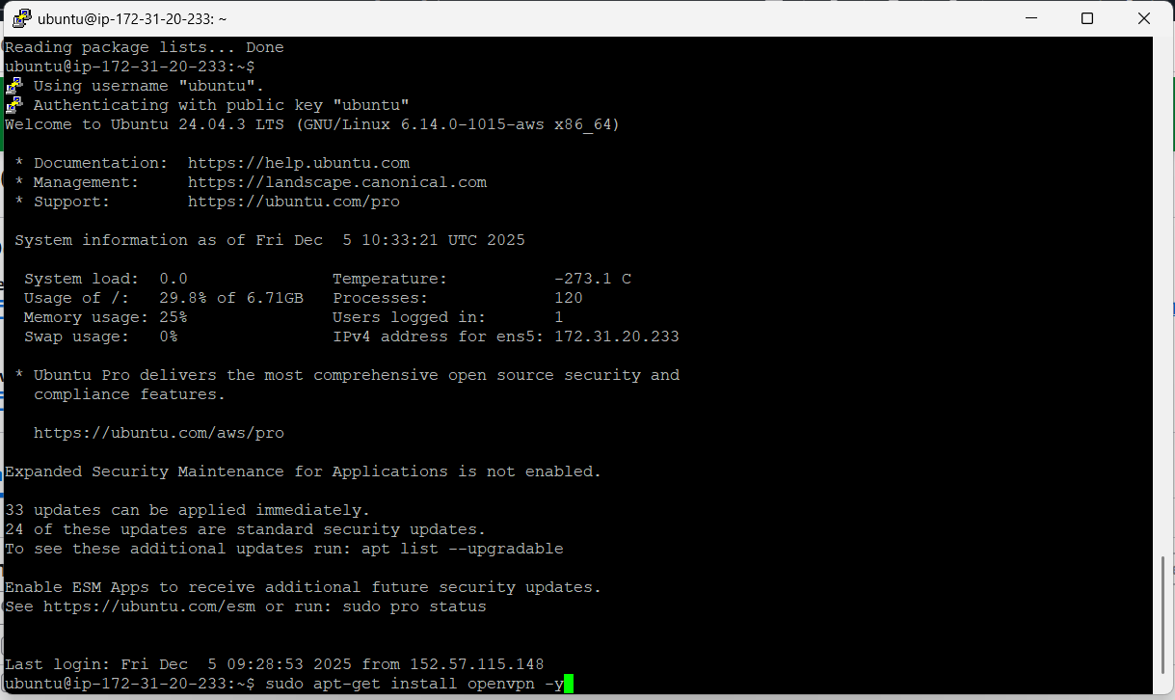
Install OpenVPN
Installing OpenVPN -> sudo apt-get install openvpn -y

Slide 27
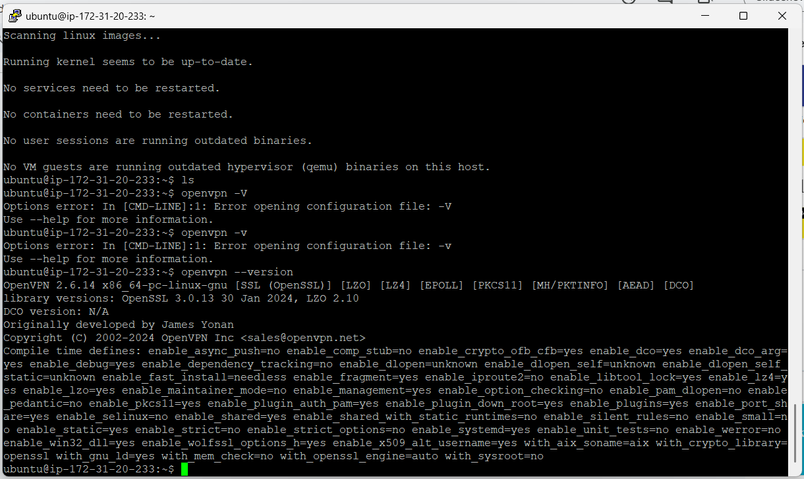
OpenVPN Version
OpenVPN Version -> openvpn –version

Slide 28
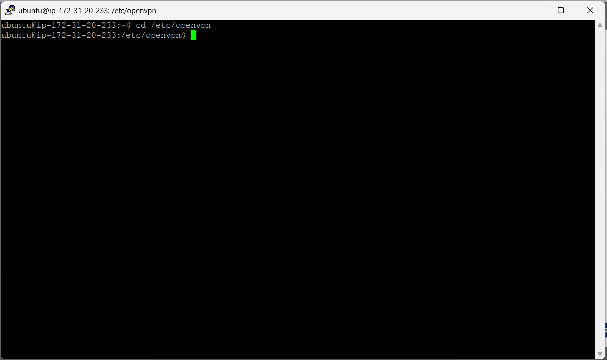
Change Directory
Changing the directory to openvpn directory -> cd /etc/openvpn

Slide 29
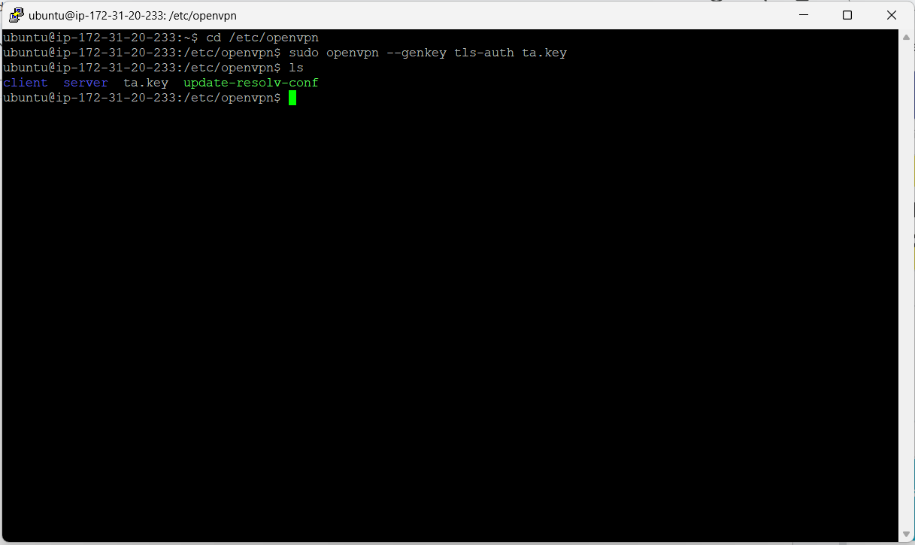
Generate TLS Key
Generating Key -> sudo openvpn --genkey tls-auth ta.key

Slide 30
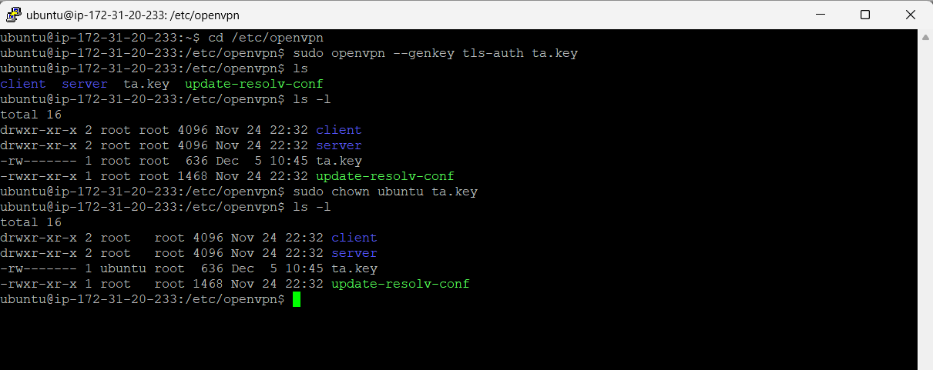
Changing the ta.key destination from root to ubuntu
Generating Key -> sudo chown ubuntu ta.key
List all to check -> ls -l

Slide 31
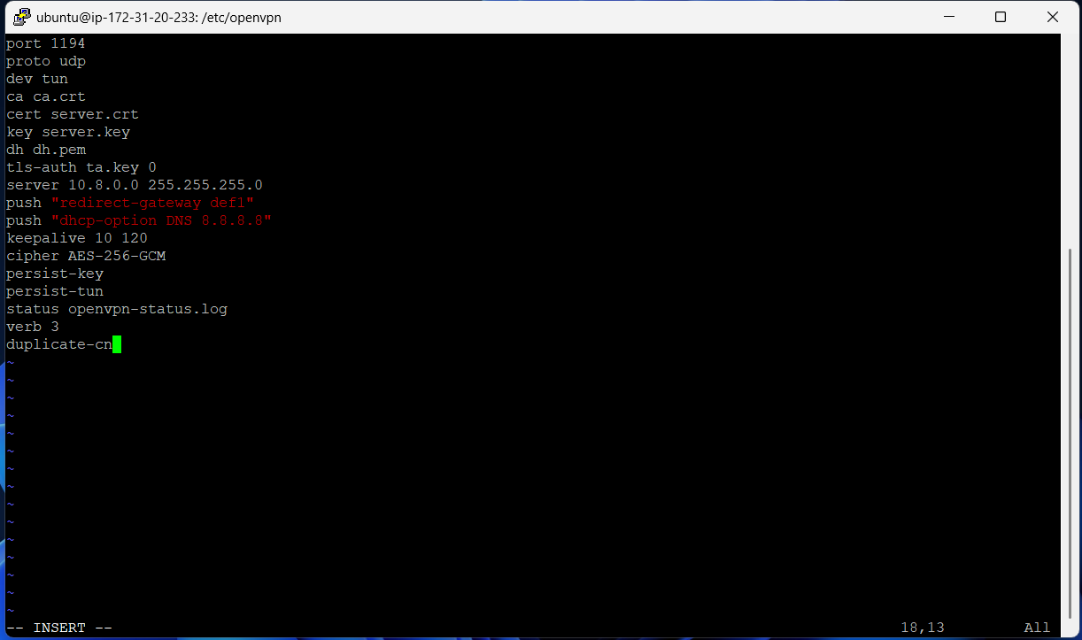
Create Server Configuration file
Create server configuration file -> vi server.conf

Slide 32
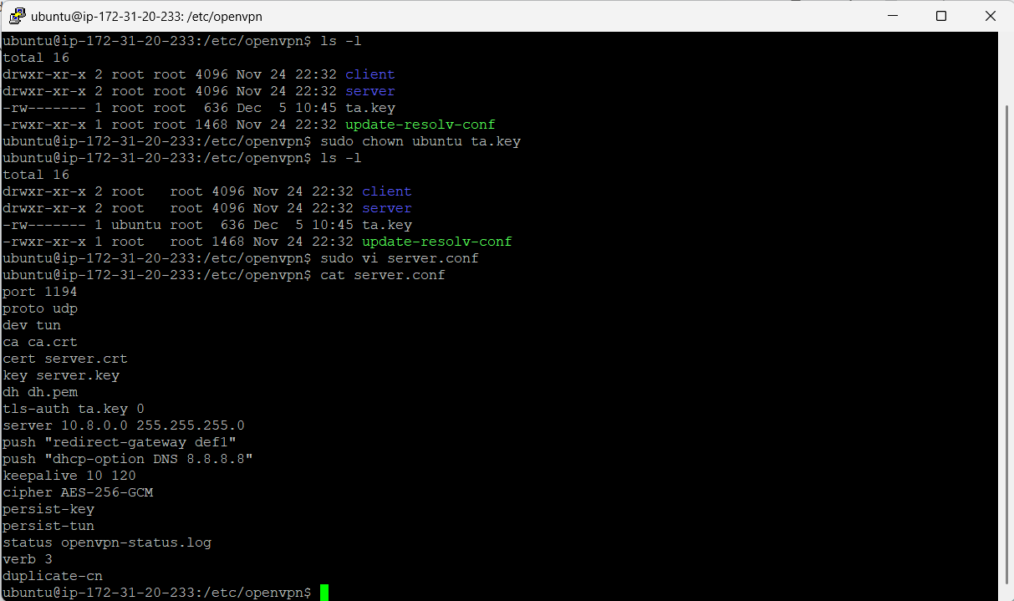
Checking the server.conf file
Check server configuration file -> cat server.conf

Slide 33
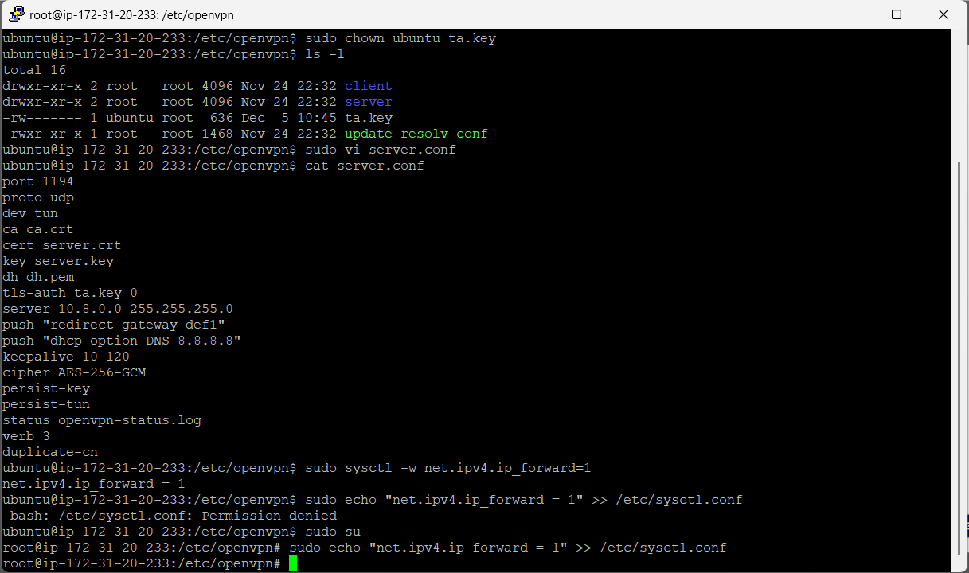
Ip forwarding
In Ubuntu, user -> sudo sysctl -w net.ipv4.ip_forward=1
In root user -> sudo echo "net.ipv4.ip_forward = 1" >> /etc/sysctl.conf

Slide 34
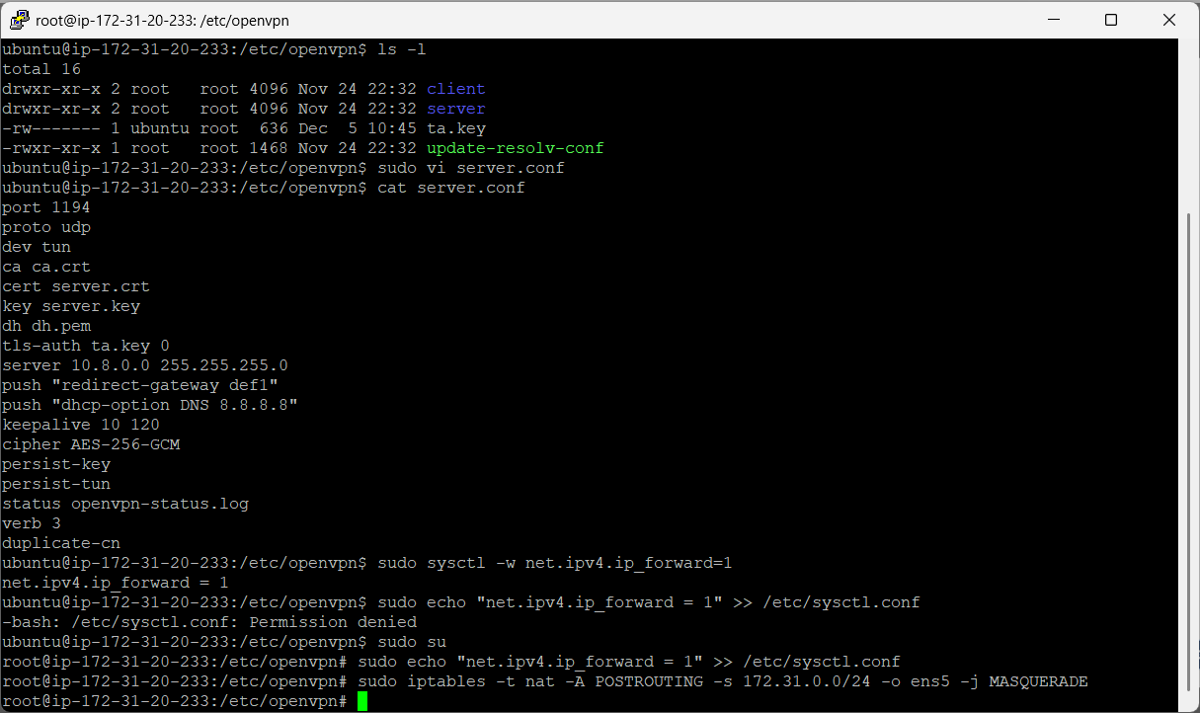
Creating IP Table
In root user -> sudo iptables -t nat -A POSTROUTING -s 172.31.0.0/24 -o ens5 -j MASQUERADE

Slide 35
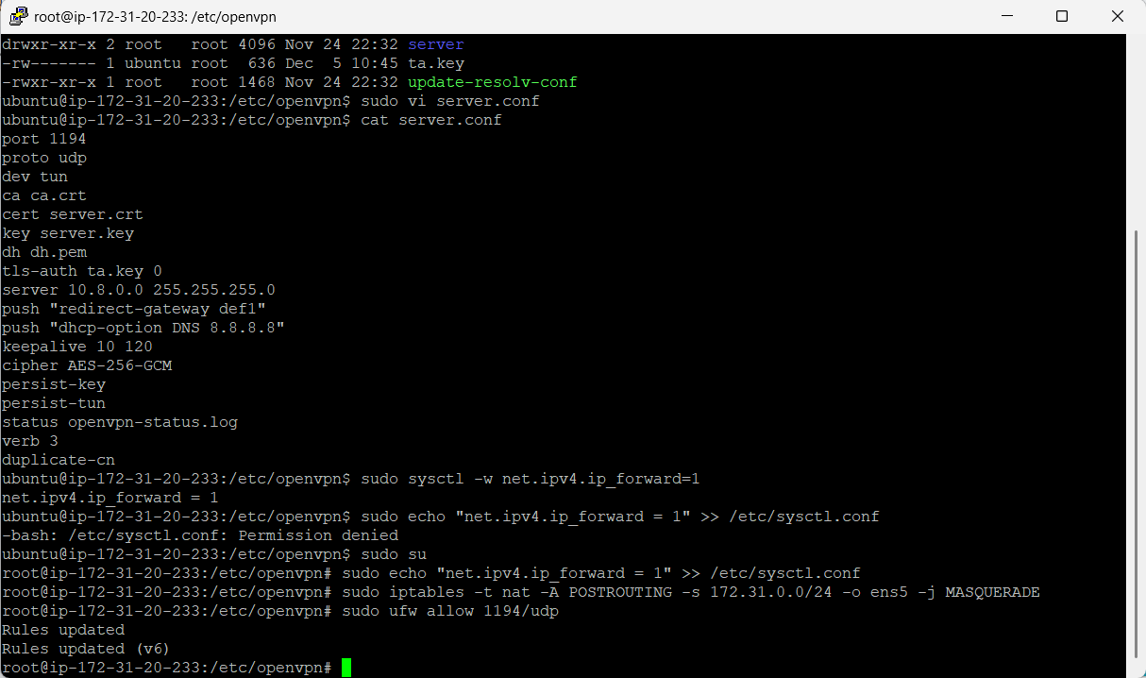
Allow Firewall for UDP
In root user -> sudo ufw allow 1194/udp

Slide 36
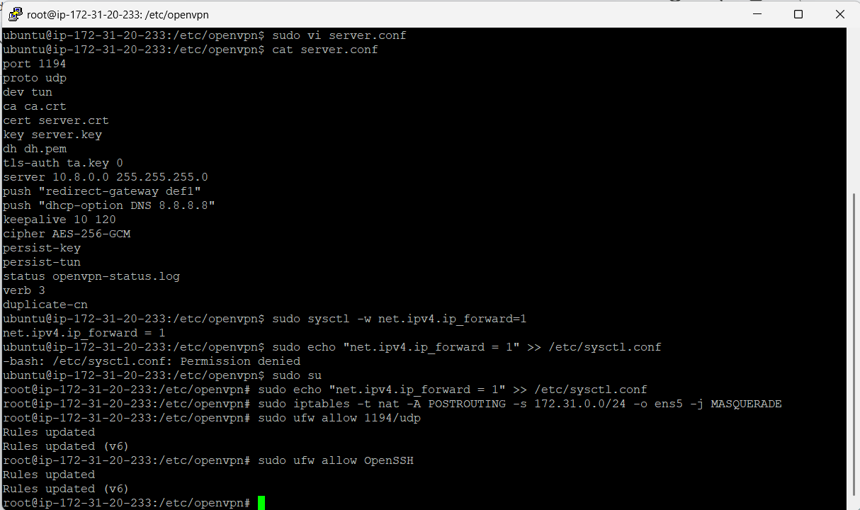
Allow Firewall for OpenSSH
In root user -> sudo ufw allow OpenSSH

Slide 37
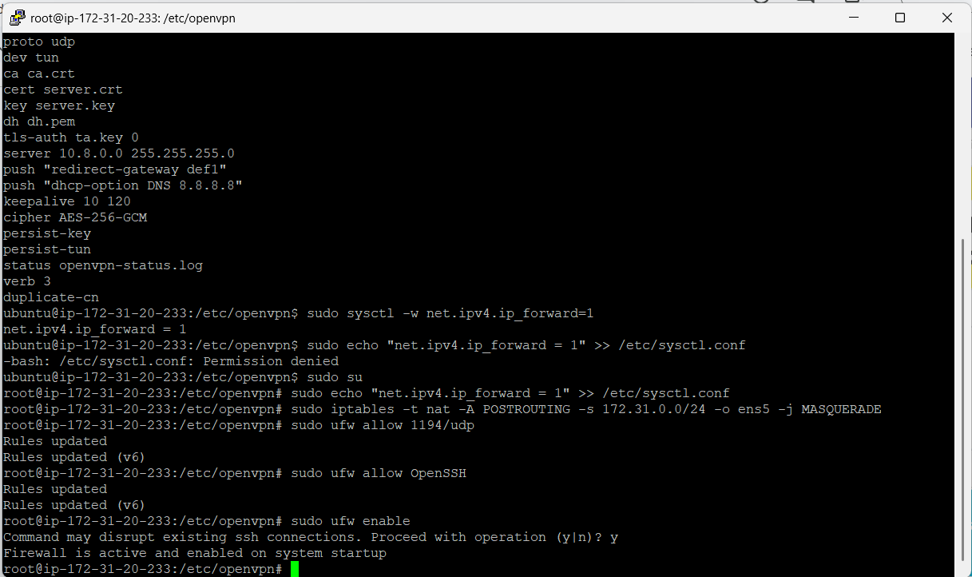
Enabling the Firewall
In root user -> sudo ufw enable

Slide 38
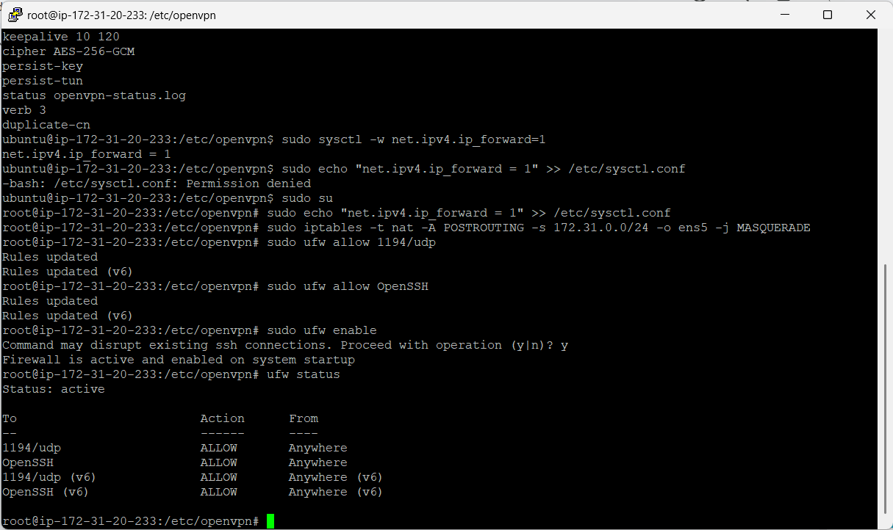
Check the Firewall status
In root user -> ufw status

Slide 39
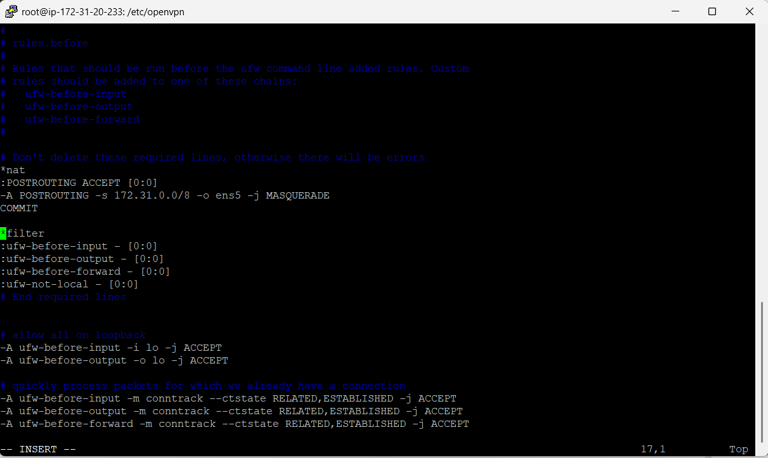
Editing the ufw before.rules by adding nat
In root user -> Vi /etc/ufw/before.rules

Slide 40
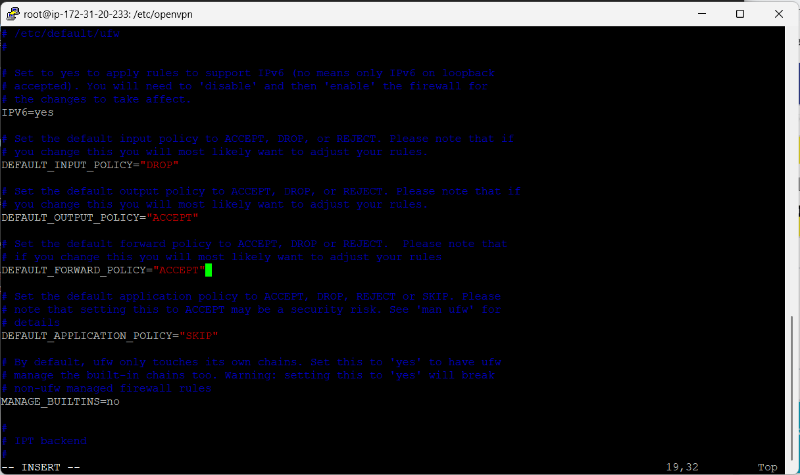
Update default ufw firewall
In root user -> vi /etc/default/ufw

Slide 41
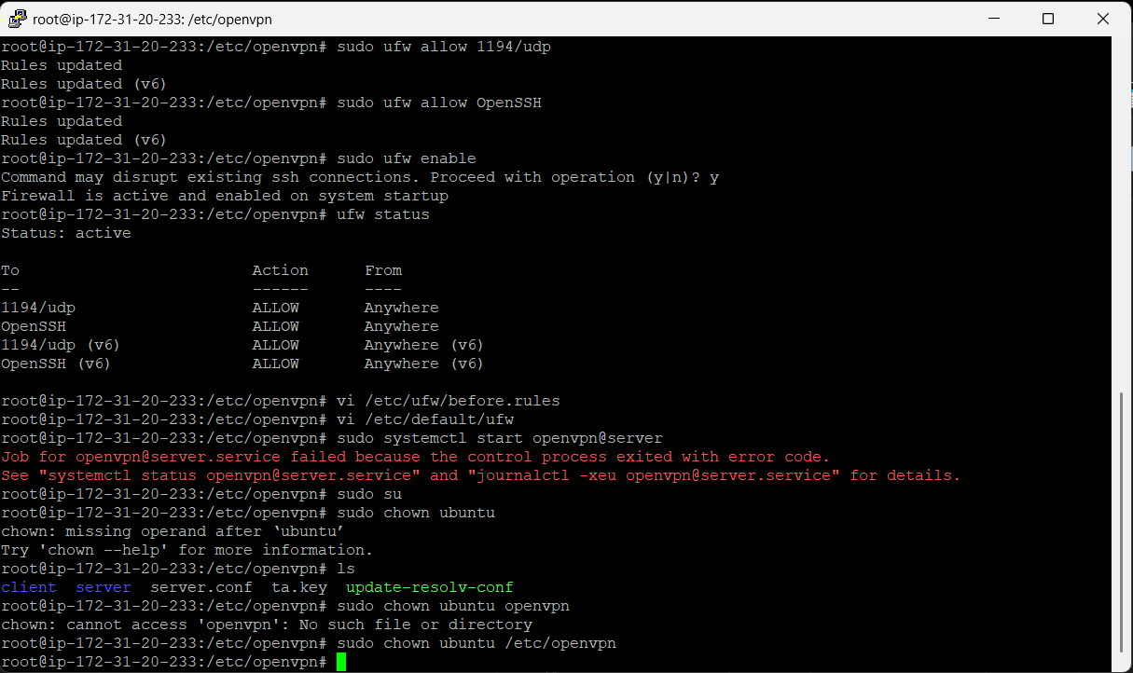
Change the access to ubuntu
To access the files from Host Machine to VM ->
In root user -> sudo chown ubuntu/etc/openvpn

Slide 42
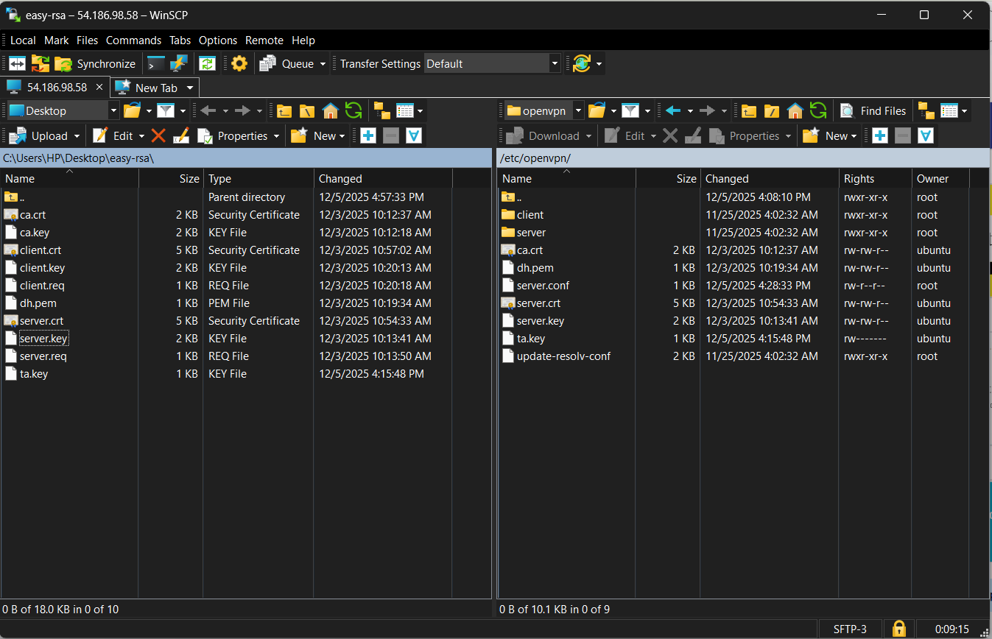
Transferring files from the host machine to VM
Transfer ca.crt, dh.pem, server.crt, server.key to VM

Slide 43
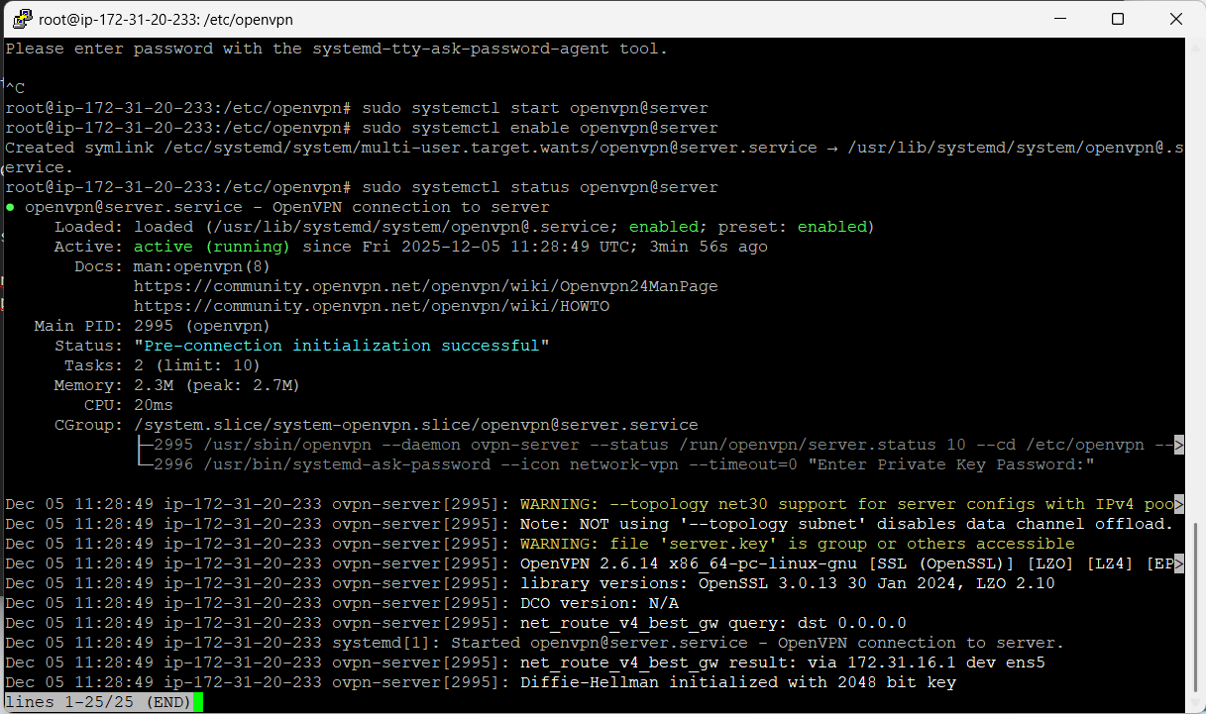
Enable the openvpn server
sudo systemctl start openvpn@server
sudo systemctl enable openvpn@server

Slide 44
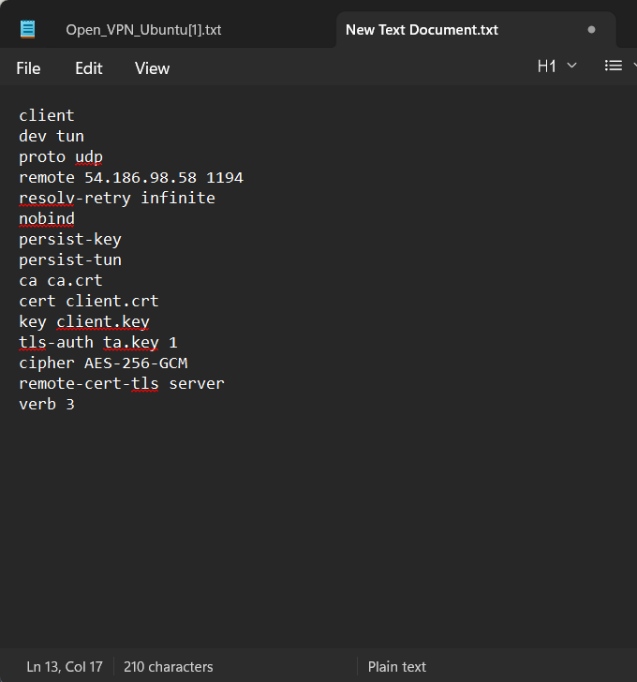
Creat the Client file
Save the file as client.ovpn, and save in the same folder where easyrsa files are.

Slide 45
Creat the Client file
Save the file as client.ovpn, and save in the same folder where easyrsa files are.

Slide 46
Creat the Client file
Save the file as client.ovpn, and save it in the same folder where the easyrsa files are.

